Slide 1

THREADING IN

Slide 2
Process Vs Thread
Process
Typically Independent
Has considerably more state information than thread
Separate address spaces
Interact only through system PC
Thread
Subsets of a process
Multiple threads within a process share process state, memory etc.
Threads share their address space

Slide 3
Lifecycle of Thread
Dead
Running
Blocked
Runnable
New

Slide 4
Single threaded & Multiple threaded process
Theads of
Execution
Common
Single Instruction
Stream
Multiple Instruction
Stream

Slide 5
What is Multi-Threading?
Runnable
Start()
Run()
New Thread()
C# support Multitasking strongly.
Multitheading == Multitasking
using System.Threading*
using Thread class
New
Running
End of Execution
Sleep().Wait()
Death
Waiting

Slide 6
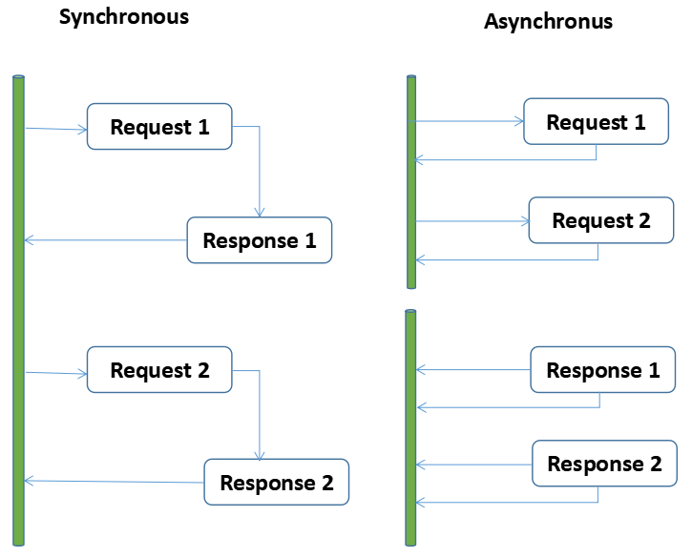
Synchronous & Asynchronus Programming
Synchronous Programming -
the first task in a program must finish processing before moving on to executing the next task
Asynchronous Prgramming -
a second task can begin executing in parallel, without waiting for an earlier task to finish.
Async/Await is single thread event based model - Which allows you to run code out-of - order until the line of code await.

Slide 7
Asynchronous Prgramming
With Asynchronous programming, we can execute tasks concurrently with the main program execution.
The async and await keywords simplify asynchronous programming in C#.
If the async method does not contain an await operator, the method executes synchronously.

Slide 8
How to implement an asynchronous style in C# applications.
Implement by delegate
class Program
{
delegate void delHugeTask();
static void Main(string[] args)
{
//Create object to delegate
delHugeTask objHugeTask = new delHugeTask(Program.HugeTask);
//Call the delegate asynchoniously
objHugeTask.BeginInvoke(new AsyncCallback(Program.callbackFunction),objHugeTask);
}
//Callback function to return result from Huge Task function
public static void callbackFunction(IAsyncResult obj)
{
}
public static void HugeTask()
{
System.Threading.Thread.Sleep(5000);
Console.WriteLine("Huge Task Finished");
}
}
}

Slide 9
Implement by async and await keyword
class Program
{
static async Task Main(string[] args)
{
var sw = new Stopwatch();
sw.Start();
Task task1 = doWork();
Task task2 = doWork();
await Task.WhenAll(task1, task2);
sw.Stop();
var elapsed = sw.ElapsedMilliseconds;
Console.WriteLine($"elapsed: {elapsed} ms");
}
static async Task doWork()
{
await Task.Delay(1500);
}
}

Slide 10
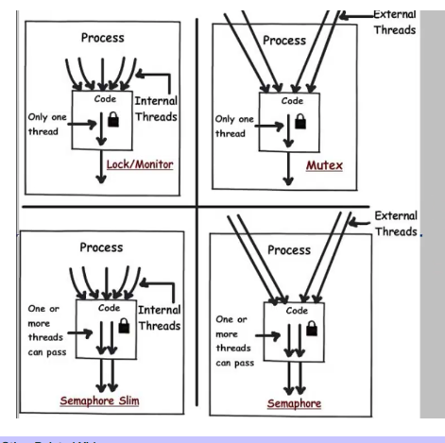
Thread Synchronization Techniques
These are the Thread Synchronization Techniques :
Lock - allows only one thread to enter the part that's locked and the lock is not shared with any other processes & internally wraps the Enter and Exit methods in a try… finally block with exception handling.
Monitor - we use try and finally block explicitly to release lock properly.
Mutex - the same as a lock but it can be system wide (shared by multiple processes).
Semaphore - does the same as a mutex but allows x number of threads to enter, this can be used for example to limit the number of cpu, io or ram intensive tasks running at the same time.

Slide 11
Lock in Classes
lock(Variable) Statement
Example
class Account
{
long val = 0; // this class should behave like a monitor
public void Deposit(long x)
{
lock (this) { val += x; } // only 1 thread at a time may execute this statement
}
public void Withdraw(long x) { lock (this) { val -= x; }
}
}
Lock can be set to any object
object semaphore = new object();
...
lock (semaphore) { ... critical region ... }
No synchronized methods like in Java

Slide 12
Monitor in Classes
C#’s lock statement is in fact a syntactic shortcut for a call to the methods Monitor.Enter and Monitor.Exit, with a try/finally block.
Example
Monitor.Enter (_locker);
try
{
if (_val2 != 0) Console.WriteLine (_val1 / _val2);
_val2 = 0;
}
finally { Monitor.Exit (_locker); }

Slide 13
Mutex in Classes
A common use for a cross-process Mutex is to ensure that only one instance of a program can run at a time.
Example
class OneAtATimePlease
{
static void Main()
{
using (var mutex = new Mutex (false, "oreilly.com OneAtATimeDemo"))
{
if (!mutex.WaitOne (TimeSpan.FromSeconds (3), false))
{
Console.WriteLine ("Another app instance is running. Bye!");
return;
}
RunProgram();
}
}
static void RunProgram()
{
Console.WriteLine ("Running. Press Enter to exit");
Console.ReadLine();
}
}

Slide 14
Semaphores in Classes
Semaphores can be useful in limiting concurrency — preventing too many threads from executing a particular piece of code at once.
Example
class TheClub // No door lists!
{
static SemaphoreSlim _sem = new SemaphoreSlim (3); // Capacity of 3
static void Main()
{
for (int i = 1; i <= 5; i++) new Thread (Enter).Start (i);
}
static void Enter (object id)
{
Console.WriteLine (id + " wants to enter");
_sem.Wait();
Console.WriteLine (id + " is in!"); // Only three threads
Thread.Sleep (1000 * (int) id); // can be here at
Console.WriteLine (id + " is leaving"); // a time.
_sem.Release();
}
}

Slide 15
AutoResetEvent and ManualResetEvent
ManualRestEvent and AutoResetEvent are thread synchronization events used in .Net Threading Synchronization.
ManualResetEvent -
when signaled, releases all the waiting threads.
The event should be reset manually else none of the threads will be in a wait state which is supposed to be.
AutoResetEvent –
when signaled, releases a single waiting thread.
The event gets reset automatically.
One thread will be released and the rest of the threads if any will continue to remain in a wait state until they are signaled

Slide 16
ManualResetEvent
Initialize the event –
private static ManualResetEvent manualreseteventObj = new ManualResetEvent(false);
WaitOne() –
manualreseteventObj.WaitOne();
WaitOne(Int32) –
bool isSignaled = manualreseteventObj.WaitOne(200);
Reset() –
manualreseteventObj.Reset();
Set() –
manualreseteventObj.Set();

Slide 17
AutoResetEvent
Initialize the event –
private static AutoResetEvent autoreseteventObj = new AutoResetEvent(false);
WaitOne() –
autoreseteventObj.WaitOne();
WaitOne(Int32) –
bool isSignaled = autoreseteventObj.WaitOne(200);
Reset() –
autoreseteventObj.Reset();
Set() –
autoreseteventObj.Set();

